Slide 1



SOCIAL MEDIA MARKETING AND MANAGEMENT
The Síkat Agency
Brand Better, Strategize smarter
PREPARED FOR CLIENT_NAME_HERE

Slide 2


WHO WE
ARE
Welcome to The Síkat Agency, a full-service Social media marketing and management agency focused on social media management. We're proud to present our proposal for a comprehensive social media strategy for your business.
In the digital era, social media has emerged as a transformative force in business, reshaping the way companies interact with customers and market their products. With the advent of platforms like Facebook, Twitter, Instagram, and LinkedIn, the business landscape has seen a paradigm shift from traditional marketing to dynamic, interactive customer engagement. Social media offers unprecedented access to large audiences, enabling businesses to amplify their brand message, gather valuable consumer insights, and respond to market trends in real-time. The Sikat Agency recognizes this revolution, positioning ourself as the compass that guides businesses through the complex terrain of social media marketing and management, ensuring that our clients not only adapt but thrive in this new digital frontier.
Mission:
The Sikat Agency is steadfast in its mission to redefine the essence of community-building within the digital landscape, embracing its continuously evolving cultural manifestations. Our goal is to craft and nurture an ecosystem where authentic connections flourish, driven by innovative strategies that resonate with the heartbeat of the digital age.
Vision:
Our vision is to pioneer an interconnected ecosystem where consumers, communities, and brands converge in meaningful engagement. We envision a world where every digital interaction weaves a stronger bond, creating a tapestry of relationships that propel businesses and individuals towards mutual growth and success.
The Sikat Agency offers a suite of comprehensive marketing solutions that extend beyond the boundaries of conventional social media management. By integrating a holistic approach to digital marketing, the agency crafts a broader strategy that encompasses social media, content creation, SEO, and targeted advertising. This integration ensures that each aspect of a brand's online presence is synergized, working in concert to amplify their message, engage with their audience more effectively, and drive meaningful results. The Sikat Agency's commitment to this integrated strategy positions its clients at the forefront of digital innovation, ensuring they harness the full potential of the internet's expansive reach.
As The Sikat Agency looks to the horizon, innovation and growth are at the core of its roadmap. The agency is poised to embrace and pioneer cutting-edge trends in social media marketing, such as the integration of artificial intelligence for personalized customer interactions and the utilization of data analytics for more targeted campaigns. The Sikat Agency is also set to expand its services to encompass emerging platforms and technologies, ensuring their clients benefit from the latest digital marketing innovations. By staying ahead of the curve, The Sikat Agency is dedicated to delivering growth and success for its clients in the ever-evolving landscape of social media marketing.
1

Slide 3
Contents
Pricing Comparison
2.Target Audience
3. Competitors
4. SWOT
5. Target Audience
6. KPI’s

Slide 4

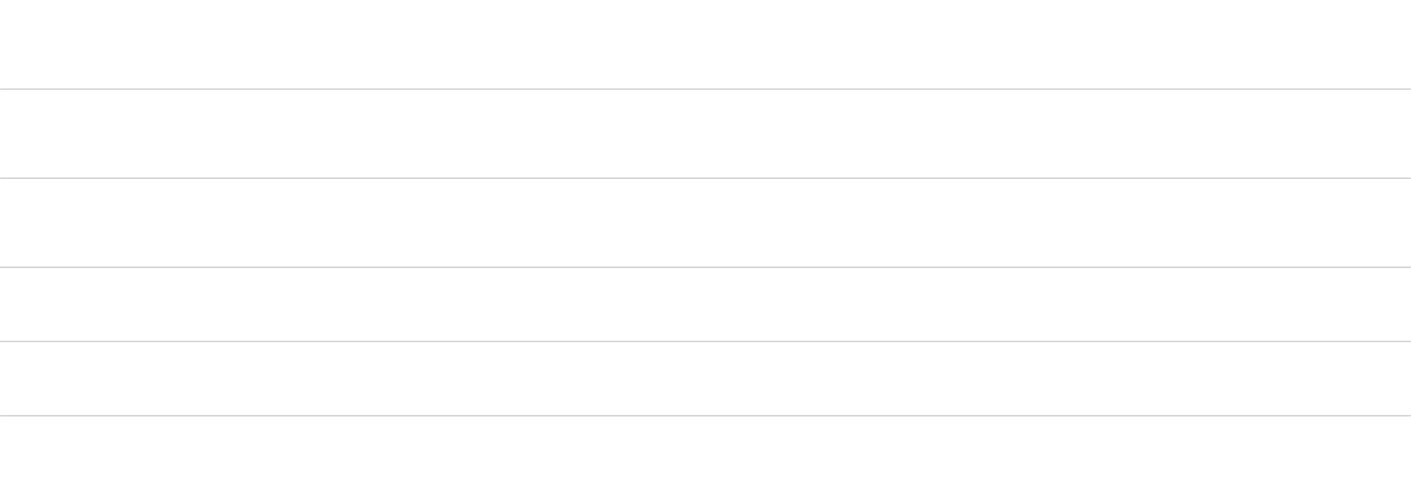




Pricing/Feature Comparison
Do a side-by-side comparison to show how your brand stacks vs. the competition
Brand
Aggregated Acceptance Rate % Top 3 Choice Schools/Total Years Experience
SAT/ACT Prep
PR Presence/Brand Awareness
Costs Per Year/Additional Services Rate/Hr.
Direct College Relationship
ID Future Stars
96% over 6.5K students, support ALL Colleges; Trademark on IDFS College Intelligence Data Science with proven results
$80K Yr. $400/hr.
College wise
92%; over 30K students, 25+years experience/
$10k Yr. @$200/hr.
Ivy Wise
91% acceptance over "thousands of students"/26 years experience/Heavily focused on Ivy
$40K Yr./@$300/hr.
International College Counselors
94% over 10.1K students; 25+ years experience; Non Ivy Support
$20-$30K/yr.; $200/hr.
Prepory
92% over 14K students; 20+ years Mostly Ivy but have fairly strong focus on Non-Ivy e.g. UF, etc.
$15k/yr. 200/hr.
Command Education
94%; NO DATA on # of Students; 8 years experience; Heavy IVY League but tout they work with Non-Ivy but do not mention anywhere
120K Yr./$480K for 4 years

Slide 5
Competitors
Plot your competitors position in the marketplace relative to your brand.
Challengers
Leaders
ID Future Stars
College Wise
Ivy Wise
International College Counselors
Prepory
Command Education
Niche Players
Visionaries

Slide 6
SWOT Analysis
Strengths
Weaknesses
Success is numbers of students admitted to top colleges
Potential for cannibalization of personal and company brand
Neg Press
Proven Experience in industry
Brand Awareness and reach is large
S
W
Opportunities
T
Threats
O
International Exposure
Leverage network which is extensive
PR Exposure
PR Neg PR
Pricing from Competitors must be overcome

Slide 7


Target Audience
75%
High Net Work/High Profile Parents
25%
Middle Class/Upper Middle Class/Under Privileged kids

Slide 8

Let's beat ‘em!

Slide 9





Contact
You can reach us for any questions or to move forward with our proposal.
475 Bartram st. SE Atlanta, GA 30316
424 666 9753
info@thesikatagency.com
thesikatgency.com
9

